Slide 1
Cryptography Project
Using C++
CPSC 230 - Professor Thamira Hindo
Ravi Patel

Slide 2
Objective
To develop a C++ program that will use cryptography to encrypt and decrypt a keyword, referred to in my project as the code word.

Slide 3
Introduction
Cryptology dates back to approximately 1900 B.C. when it was discovered that an Egyptian scribe used nonstandard hieroglyphics in his communication.
We’ve all probably used cryptology in our lives, for example — speaking in pig Latin. We can use cryptology in order to hide information.
The Caesar Cipher was created by Julius Caesar to communicate with his army — so the enemy side would not be able to decipher messages without the encryption key.

Slide 4
Caesar Cipher
The Caesar Cipher is able to encrypt and decrypt messages by using a “Key”.
The key that is used will replace letters down the alphabet.
For example, ABC with a key of 3 would become DEF when encrypted.

Slide 5
Theory & Calculation
To begin, we need the user to input a code word
Next, we ask the user for a key (the number of places letters will be shifted over)
Then we ask the user whether they would like to encrypt or decrypt the code word given
Finally, we display the encrypted code word and ask the user if they want to continue
I chose to do this task by creating functions for specific parts, and using an array of letters (for input) and a temporary array (encrypted code word)

Slide 6
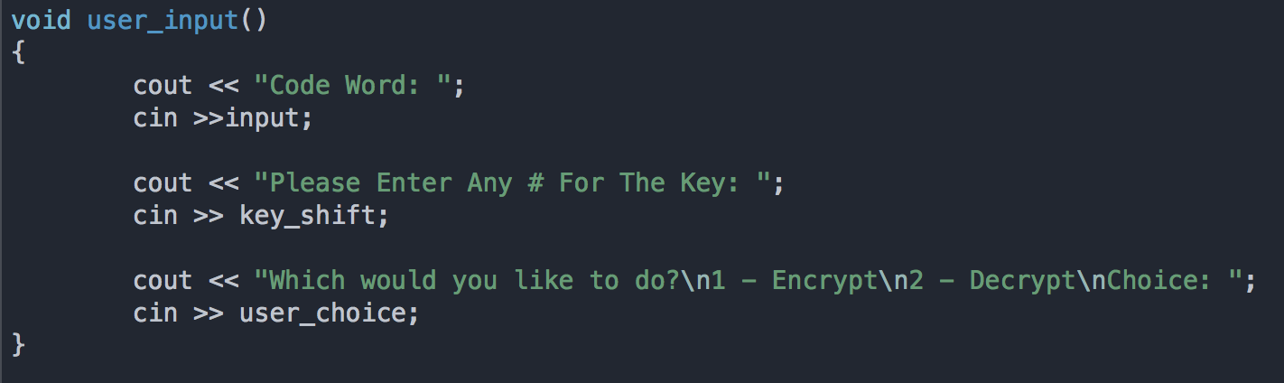
Program Functions
user_input()

Slide 7
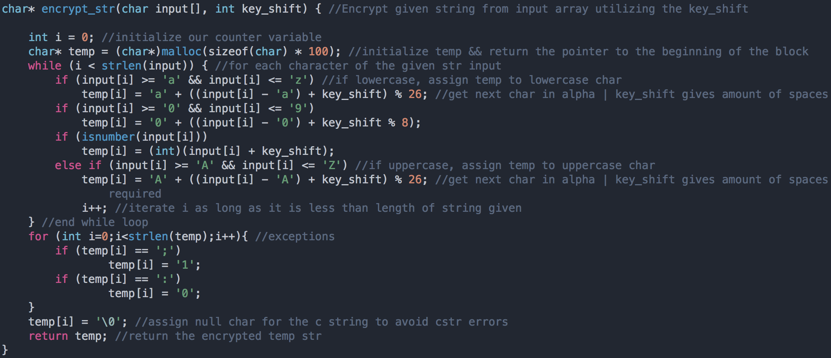
encrypt_str()

Slide 8
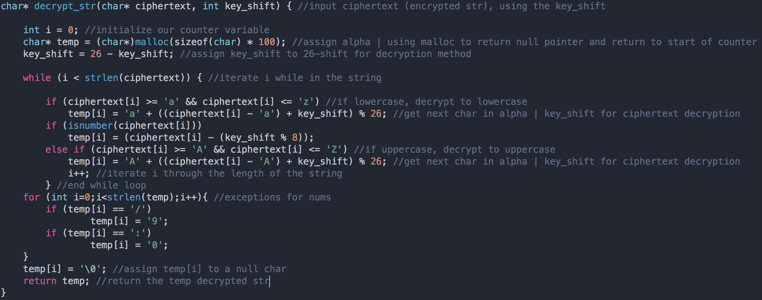
decrypt_str()

Slide 9
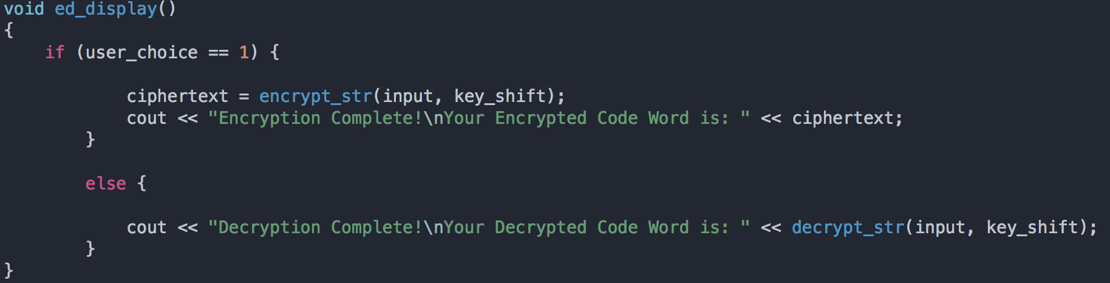
ed_display()

Slide 10
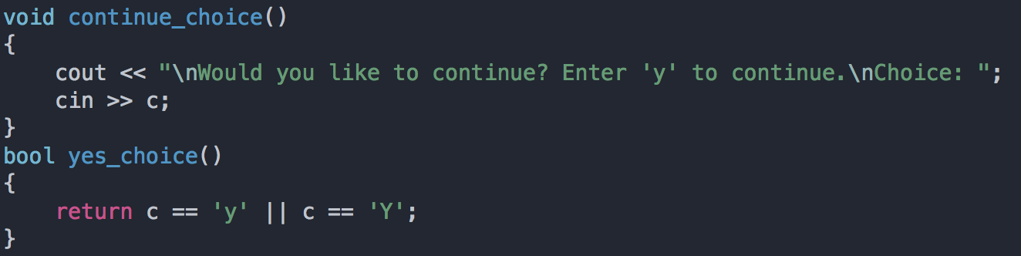
continue_choice(), yes_choice()

Slide 11
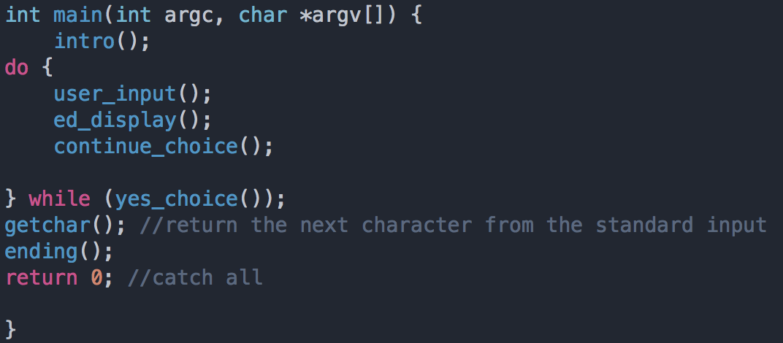
main()

Slide 12
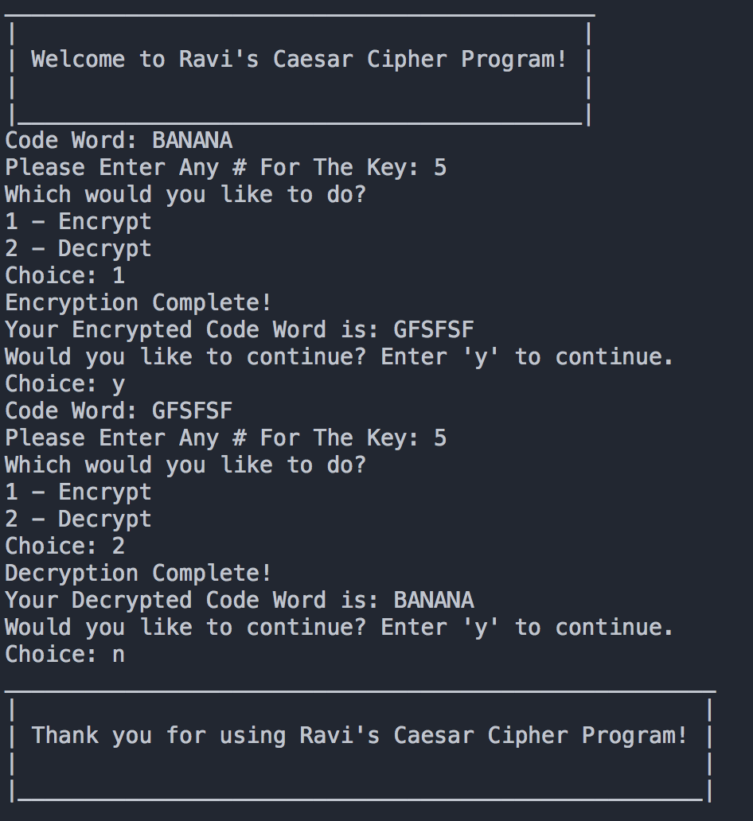

Slide 13
Future Work
Although my program has all the conditions met for a traditional Caesar Cipher program, I attempted to allow numbers as input as well — but was unsuccessful in finding a work around to encrypt and decrypt numbers.
Because the program uses the ASCII alphabet, it was difficult for me to find a way to keep numbers as numbers, instead of letters or symbols.

Slide 14
Thank you!

